Slide 1



Optislot (Just Automated Real-time Intelligent Vehicle Parking System)
Smart Cities & Intelligent Transportation Systems
By Reshekumar V
Department of Computer Science and Engineering, KPR Institute of Engineering and Technology
Notes:
1

Slide 2
Problem: The Parking Predicament
Inefficiency
High CAPEX
Maintenance
High search time for parking causes congestion and fuel waste.
Traditional systems need physical sensors at every slot (1:1 ratio).
Decentralized hardware increases failure points.
Location: Urban centers, malls, and corporate campuses.
Importance: Critical to reduce infrastructure costs, traffic and carbon emission.
Notes:
2

Slide 3
Existing Scenario: The Status Quo
Current Methods:
Drawbacks:
  Slot-Sensors: Ultrasonic/magnetic loops at the Entrance Gate.
  Manual: Security guards directing traffic.
  Cost: Installing 100s of sensors is expensive.
  Rigidity: Hard to scale; requires physical cabling for every new spot.
Insufficiency: Relies on "Brute Force Hardware" instead of scalable software logic.
Notes:
3

Slide 4
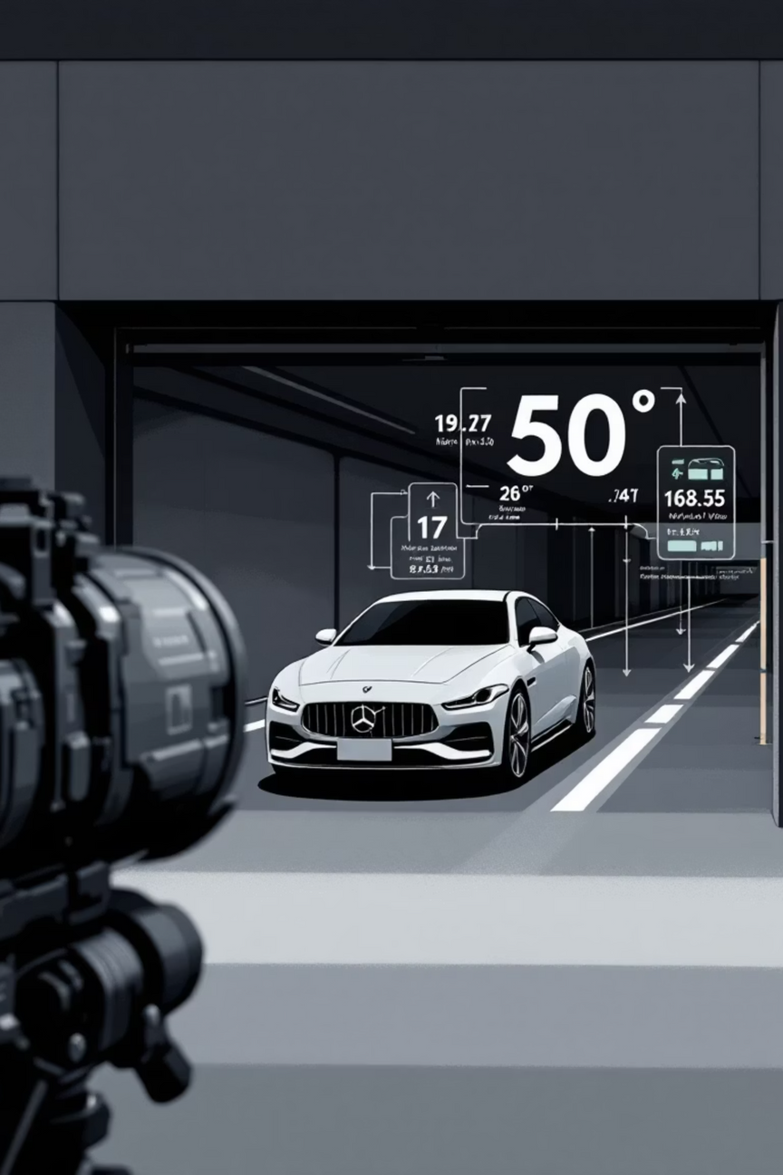
Proposed Solution: Optislot's Innovation
Core Idea: Centralized Sensor Fusion at the entry gate, removing slot-level sensors.
01
02
Optical Profiling
Logic
Camera extracts the Registration Number from the Number plate.
"Bin-Packing Algorithm" allocates the optimal slot.
03
Connectivity
Cloud Registry ensures access across changing networks.
Differentiation:
  95% Hardware Reduction: Replaces hundreds of sensors with one camera.
  Software-First: Infinite scalability without new wiring.
Notes:
4

Slide 5

System Architecture: How it Works
Dynamic QR interface
Camera input
Outputs updated QR codes
Captures vehicle ID and dimensions
Camera → Python → MongoDB → QR
MongoDB cloud registry
Local Python server
Maps dynamic IPs to static endpoints
Runs allocation and processing
Workflow:
  Input: Camera captures vehicle identity and dimensions.
  Processing: Local Python server runs allocation algorithms.
  Cloud Registry: MongoDB maps dynamic local IPs to static endpoints.
  Interface: Dynamic QR code redirects users to their assigned slot.
Notes:
5

Slide 6
Feasibility: A Practical Approach
Practicality:
Cost & Scalability:
High. Uses standard Webcams, Laptops, and Free-tier Cloud (MongoDB).
  Scalable: Adding slots is a code update, not construction.
  Economical: Drastically lower installation costs vs. traditional IoT.
Challenges:
  Issue: Dynamic Network IPs.
  Fix: Automated Service Discovery via Cloud Registry.
Notes:
6

Slide 7
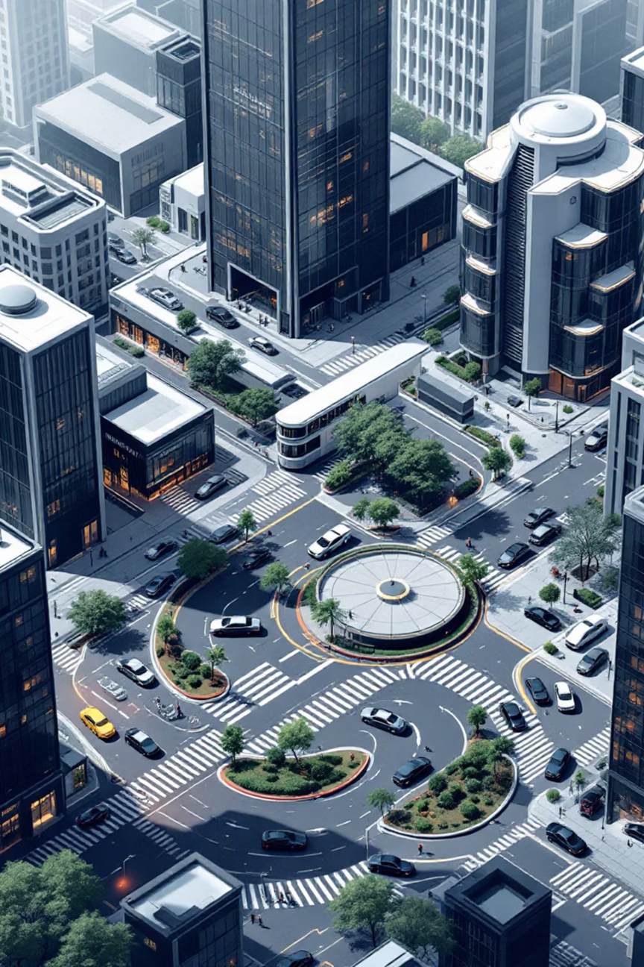




Applications & Impact
Use Cases: Multi-level car parks, automated tolls, gated communities.
Developers
Lower infrastructure overhead.
Drivers
Zero search time; guaranteed parking.
Impact:
  Tech: Shifts industry from hardware-heavy to software-defined IoT.
  Green: Direct reduction in vehicle idling emissions.
Notes:
7

Slide 8
Future Scope: Expanding Possibilities
Improvements:
Advanced Features:
  Dynamic Pricing: Demand-based automated rate adjustment.
  Find My Car - Reverse Routing: Using the system's entry logs to guide forgetful drivers back to their parked vehicle's exact location via the web interface.
  Smart Energy Orchestration: The system utilizes real-time occupancy data to automatically dim lights and deactivate ventilation in empty zones
  Predictive Occupancy Modelling: Our system logs entry timestamps to build a Predictive Model.
  The "Blacklist" Security Protocol (ANPR): Integrates with law enforcement databases to identify stolen vehicles, instantly triggering silent alarms and exit lockdowns.
  Touchless Payment Integration: RFID tag or Plate, calculates the fee, and auto-debits the user's wallet upon exit.
Notes:
8

Slide 9
Optislot: Redefining Smart Parking for a Sustainable Future
Leveraging a revolutionary software-first approach, Optislot slashes hardware needs by 95%, delivering unmatched cost efficiency, effortless scalability, and profound environmental benefits. Gain a decisive competitive edge with a solution designed for tomorrow.
Partner with us to transform your parking infrastructure.
Reshekumar V - Project Lead and Developer
Email - vrk1711@gmail.com
LinkedIn - Reshekumar V
To know more about myself, give a view to my portfolio Reshekumar V
Notes:
9

